Slide 1
Atlanta city Neighborhood segmentation and clustering
Capstone project BY
Ravindra Bhagwat

Slide 2
Atlanta CITY and Neighborhood
Atlanta city has a population of 498,000 but including the many suburbs the metropolitan area is home to about 5.6 million people. http://worldpopulationreview.com/us-cities/atlanta-population/
City has more than 200 distinct neighborhoods

Slide 3
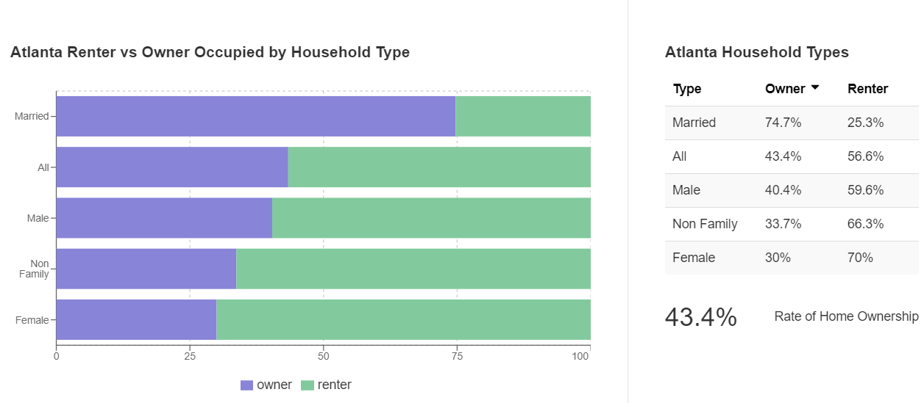
Household demographics

Slide 4
Capstone project data
Georgia zip codes with neighborhoods info https://www.zipcodestogo.com/Georgia/
Geo JSON data for Atlanta neighborhoods https://github.com/codeforamerica/click_that_hood/blob/master/public/data/atlanta.geojson
Foursqure

Slide 5
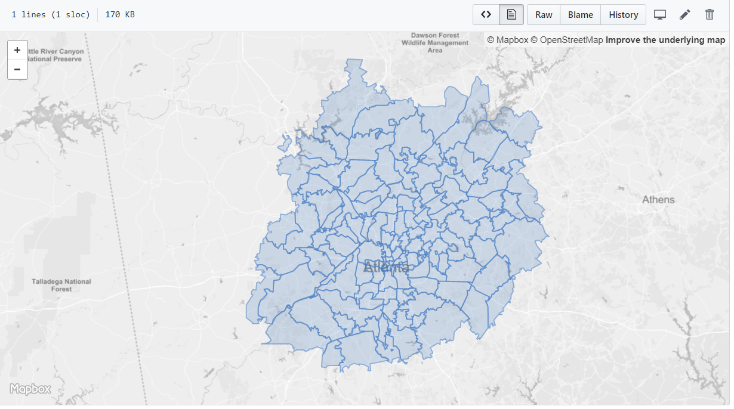
Atlanta MAP

Slide 6
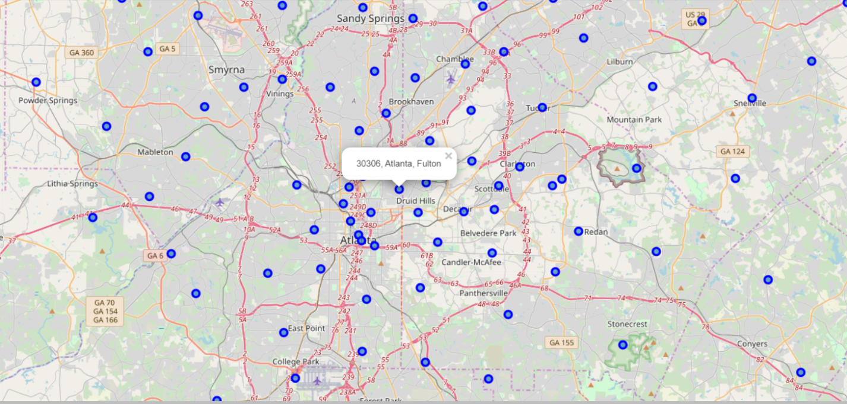
FOLIUM visualization

Slide 7
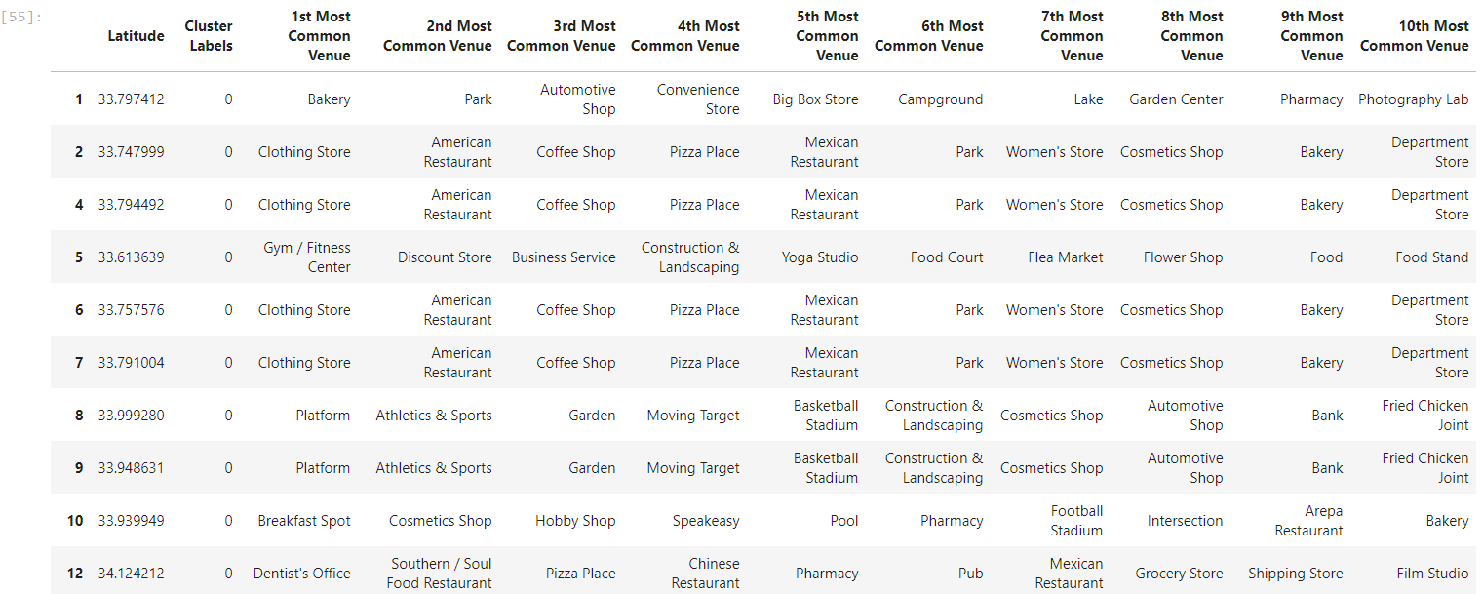
Atlanta Cluster 1- main city

Slide 8
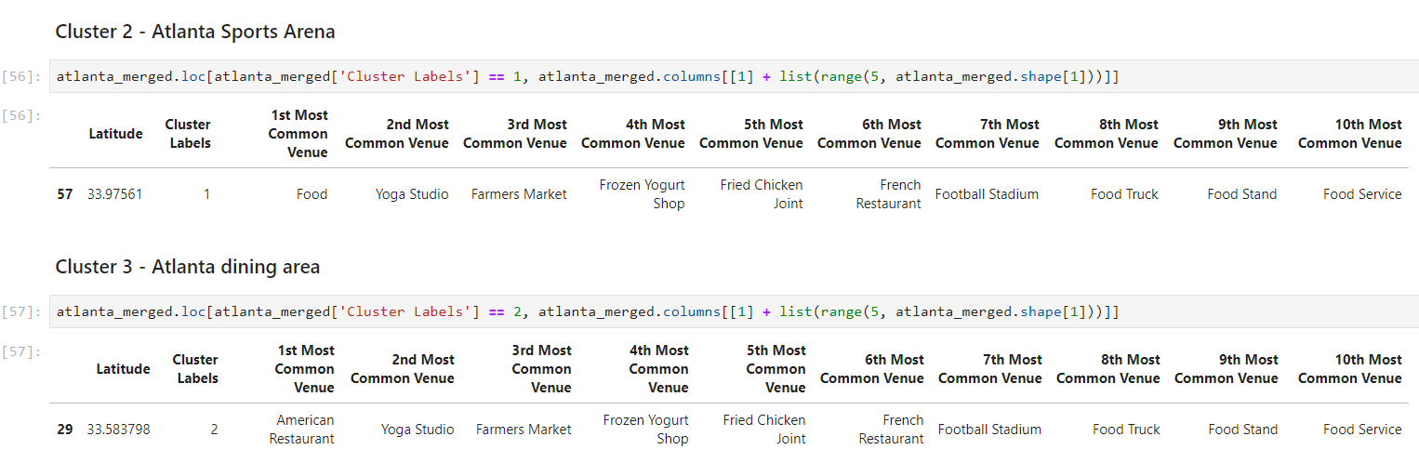
Cluster 2 & 3 – sports arena and dining

Slide 9
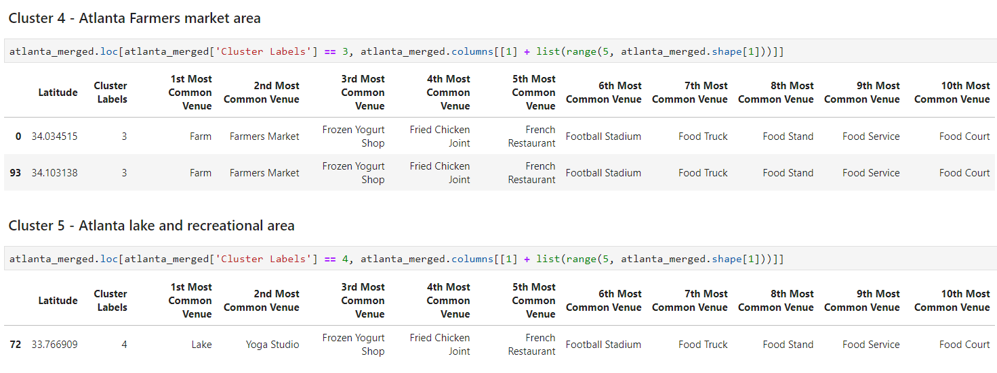
Atlanta cluster 4 & 5 – farmers market and lake area

Slide 10
conclusion
New business need to align within the cluster with same interest
Dining and other entertainment need to look at the areas with that density and at a small distance from other similar locations
People buying a house can look at the venues of interest to them

